Slide 1
Hadoop Distributed file system
The design of HDFS

Slide 2
HDFS is a file system designed for storing very large files with streaming data access patterns, running on clusters of commodity hardware.
Files that are hundreds of megabytes, gigabytes, or terabytes in size
Most efficient data processing pattern is a write-once, read-many-times pattern.
A dataset is typically generated or copied from source, and then various analyses are performed on that dataset over time.
Each analysis will involve a large proportion, if not all, of the dataset, so the time to read the whole dataset is more important than the latency in reading the first record.
Hadoop doesn’t require expensive, highly reliable hardware. It’s designed to run on clusters of commodity hardware for which the chance of node failure across the cluster is high, at least for large clusters.
HDFS is designed to carry on working without a noticeable interruption to the user in the face of such failure.

Slide 3
Areas where HDFS is not a good fit today:
Low-latency data access : will not work well with HDFS, HDFS is optimized for delivering a high throughput of data.
Lots of small files : namenode holds file system metadata in memory, the limit to the number of files in a file system is governed by the amount of memory on the namenode. As a rule of thumb, each file, directory, and block takes about 150 bytes. So,for example, if you had one million files, each taking one block, you would need at least 300 MB of memory.
Multiple writers, arbitrary file modifications:Files in HDFS may be written to by a single writer. Writes are always made at the end of the file. There is no support for multiple writers or for modifications at arbitrary offsets in the file.

Slide 4
HDFS Concepts
Blocks
Namenodes and Datanodes
HDFS Federation
HDFS High-Availability

Slide 5
Disk Blocks and Filesystem Blocks
Disk Block: The smallest unit of data that a disk can read or write. It is typically 512 bytes.
Filesystem Block: Filesystems organize data in blocks that are multiples of disk blocks, often a few kilobytes (e.g., 4 KB). This allows the filesystem to manage data more efficiently.
User Transparency: The user interacts with files of arbitrary size without concern for how the filesystem manages data in blocks.

Slide 6
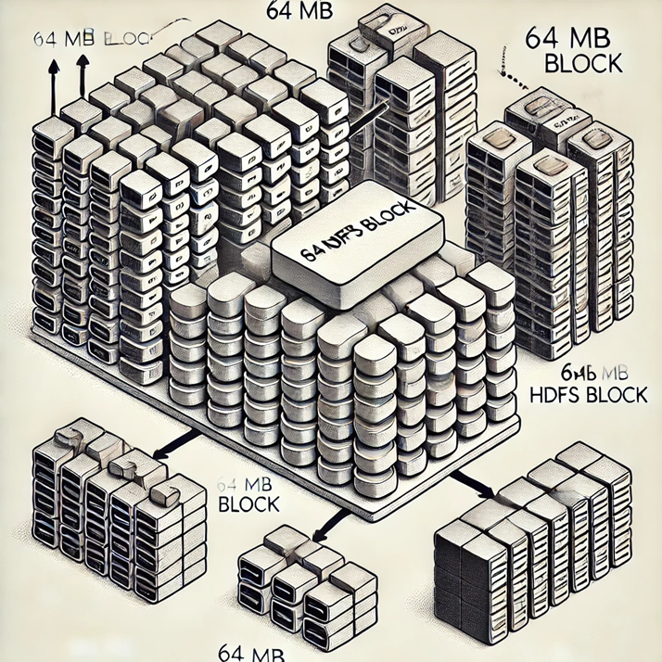
Blocks in HDFS (Hadoop Distributed File System)
HDFS Block: Significantly larger than a typical disk block, with a default size of 64 MB. Files are broken into these large block-sized chunks.
Storage Efficiency: Unlike a filesystem on a single disk, if a file is smaller than the block size, it doesn't take up the full block space.
Distributed Storage: HDFS allows blocks to be stored across multiple disks in a cluster, enabling files to be larger than any single disk in the network.

Slide 7
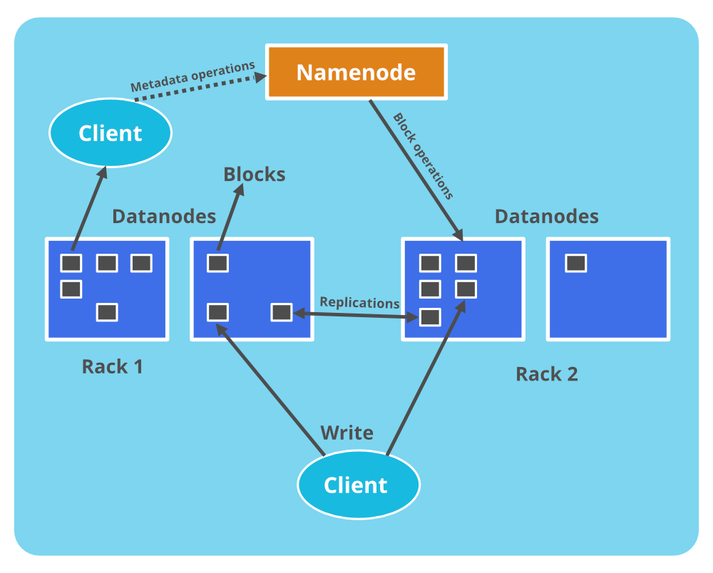
HDFS Cluster
│
├── Master Node: NameNode
│ ├── Manages Filesystem Namespace
│ │ └── Filesystem Tree and Metadata
│ ├── Stores Metadata Persistently
│ │ ├── Namespace Image (on local disk)
│ │ └── Edit Log (on local disk)
│ ├── Knows Block Locations on DataNodes
│ │ └── Reconstructs block locations from DataNodes on startup
│ └── Provides Filesystem Interface to Clients
│
├── Worker Nodes: DataNodes(workhorses)
│ ├── Store Data Blocks
│ ├── Retrieve Data Blocks on Request
│ └── Periodically Report Block Lists to NameNode
│
├── Client
│ ├── Communicates with NameNode
│ │ └── Requests Metadata and Block Locations
│ └── Communicates with DataNodes
│ └── Reads/Writes Data Blocks

Slide 8
Resilience Mechanisms for NameNode
│ ├── Metadata Backup
│ │ ├── Writes to Multiple Filesystems (e.g., Local Disk and Remote NFS)
│ │ └── Synchronous and Atomic Writes
│ └── Secondary NameNode
│ ├── Periodically Merges Namespace Image with Edit Log
│ ├── Runs on Separate Physical Machine
│ ├── Keeps a Copy of the Merged Namespace Image
│ └── Can be Used to Recover from NameNode Failure (with possible data loss)

Slide 9
Benefits of Block Abstraction in HDFS
Scalability: Files can be distributed across many disks, making it possible to store very large files.
Simplicity: Managing storage at the block level simplifies the system, particularly in distributed environments where failures can be common.
Fault Tolerance: Blocks are replicated across different machines (typically three replicas). If one block becomes unavailable due to corruption or machine failure, another copy can be used transparently, ensuring data availability.

Slide 10
HDFS Federation
A single Namenode keeps all metadata (file and block references) in memory.
Memory becomes a limiting factor with a large number of files and blocks.
Single Namenode
Metadata(File and Block References)

Slide 11
Federation allows adding multiple Namenodes to scale the system.
Each Namenode manages a different part of the filesystem namespace (e.g., /user and /share).
HDFS Federation
Namenode1
(Handles /user)
Namenode2
(Handles /share)

Slide 12

Each Namenode manages its own namespace volume and block pool.
The namespace volume contains metadata specific to that namespace.
The block pool contains blocks for files in that namespace.
Namespace Volume: /share Metadata Block Pool: Blocks for /share
Namenode1
Namespace Volume: /user Metadata Block Pool: Blocks for /user

Slide 13
Namespace volumes are independent. Failure of one Namenode doesn’t affect others.
Datanodes store blocks from multiple block pools but do not manage namespaces directly.
Namespace Volume: /user Metadata Block Pool: Blocks for /user
Namespace Volume: /share Metadata Block Pool: Blocks for /share
Namenode1
Datanodes(Shared Storage)

Slide 14
Clients use ViewFileSystem and viewfs:// URIs to access the federated HDFS cluster.
The client-side mount table maps file paths to the correct Namenodes.
Client: ViewFileSystem viewfs:// URI -> Maps paths to appropriate Namenodes.
Namenode1(Handles/user)Metadata & Blocks

Slide 15
HDFS High-Availability
Namenode Metadata Replication: The Namenode keeps all metadata (file-to-block mappings) in memory and replicates it across multiple filesystems to protect against data loss.
Secondary Namenode: This component creates checkpoints of the filesystem metadata, helping with recovery by saving periodic snapshots.
Single Point of Failure (SPOF): The Namenode is a single point of failure; if it fails, all client operations (read, write, list) are halted until recovery is completed.
Recovery from Namenode Failure: An administrator must start a new primary Namenode with a replica of the metadata, load the namespace image, replay the edit log, and collect block reports from datanodes. This recovery can take 30 minutes or more for large clusters.

Slide 16
Planned Downtime: Routine maintenance can be problematic due to long recovery times, making planned downtime and maintenance more significant concerns.
HDFS High Availability (HA) in Hadoop 2.x: Introduces a pair of Namenodes in an active-standby configuration to ensure high availability.
Shared Storage for Edit Log: Namenodes use shared storage (initially NFS, with future options like ZooKeeper-based systems) for the edit log, allowing the standby Namenode to synchronize with the active one.
Datanodes Report to Both Namenodes: Datanodes send block reports to both the active and standby Namenodes to ensure both have up-to-date block mappings.
Client Configuration for Failover: Clients must be configured to handle Namenode failover transparently, ensuring minimal disruption.

Slide 17
Failover Controller
Manages the transition between the active and standby Namenodes.
The first implementation uses ZooKeeper(open source service for co-ordinating distributed applications) to ensure that only one Namenode is active at any given time.
Each Namenode runs a lightweight failover(small efficient process) controller that monitors the Namenode for failures using heartbeats(periodic signal) and triggers a failover if a failure is detected.
An administrator can manually trigger a failover for routine maintenance, known as a graceful failover, which involves an orderly transition of roles between the Namenodes.

Slide 18
Fencing:
Ensures that a previously active Namenode is completely shut down and cannot cause data corruption or conflicts after a failover.
Mechanisms:
Includes:
Killing the Namenode’s process.
Revoking access to shared storage
Disabling network access via remote management.

Slide 19
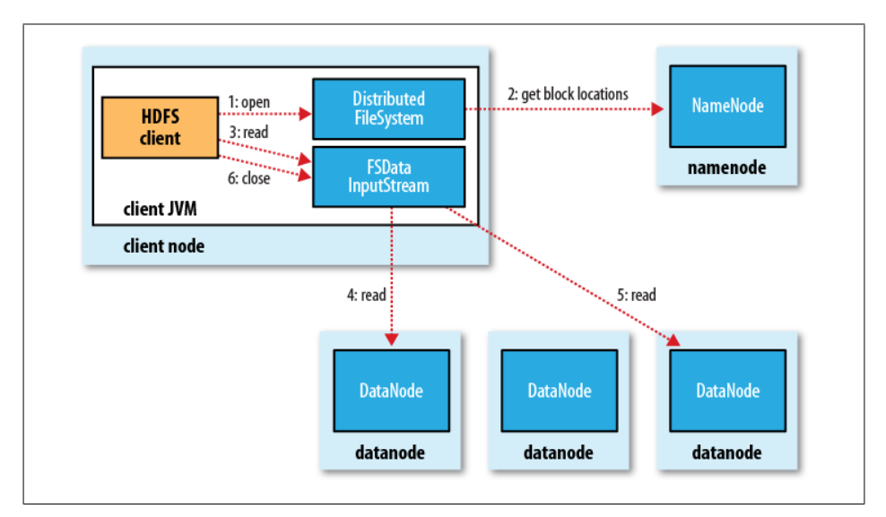
Anatomy of a File Read

Slide 20
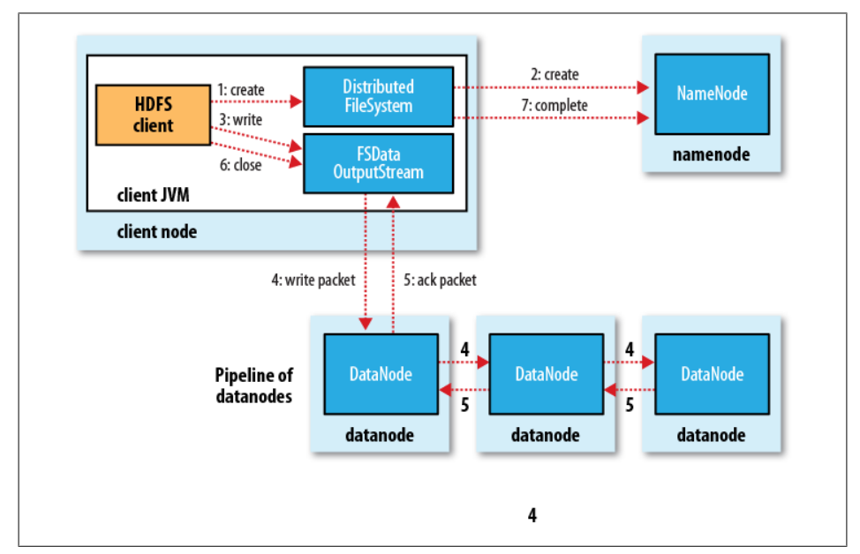
Anatomy of a File Write

Slide 21
A Weather dataset
Source: National Climatic Data Center (NCDC).
Format: Line-oriented ASCII.
Record Structure: Each line represents a record with fixed-width fields for basic elements such as temperature.
Example Record: Shows a sample line with different fields, split to highlight individual data elements.
Fields Include:
Weather station identifiers.
Observation date and time.
Latitude and longitude.
Meteorological measurements (temperature, wind direction, visibility, etc.).
Note: Fields are packed into a single line with no delimiters in the actual data file.

Slide 22
File Organization:
Directory Structure: Organized by year and weather station.
Years: Directories for each year from 1901 to 2001.
Files: Each year contains gzipped files for each weather station.
Example for 1990: Files are named based on weather station identifiers and concatenated by year (e.g., 010010-99999-1990.gz).
Data Pre-processing:
Large number of small files (tens of thousands).
Concatenate yearly files into a single file per year to improve processing efficiency.
CHALLENGES PRE PROCESSING

Slide 23
Uneven Work Distribution: Some processes (handling larger years) will take much longer to complete than others (handling smaller years).
Combining Results: If you processed data by year and combined the results by simply concatenating and sorting, would need to aggregate results in a way that correctly reflects the data for each year.
Limitations of Single-Machine Processing

Slide 24
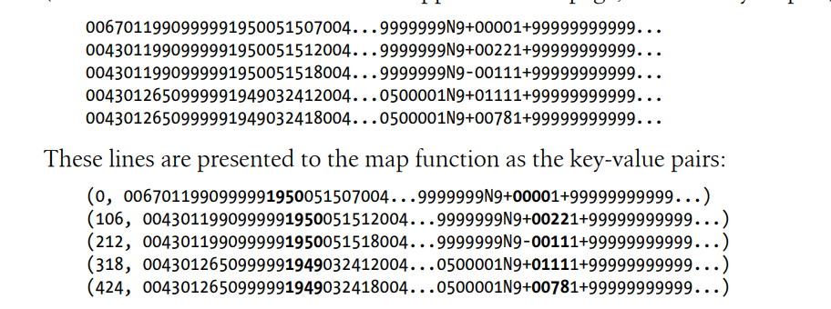
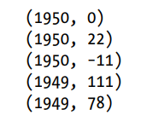

MapReduce(Max temp recorded each year)

Slide 25
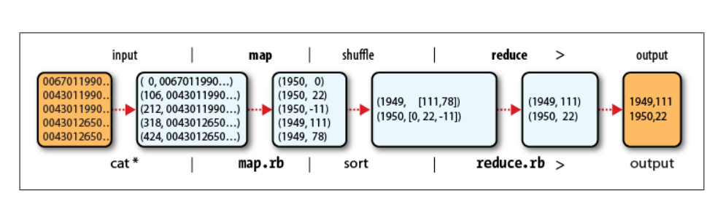

Slide 26
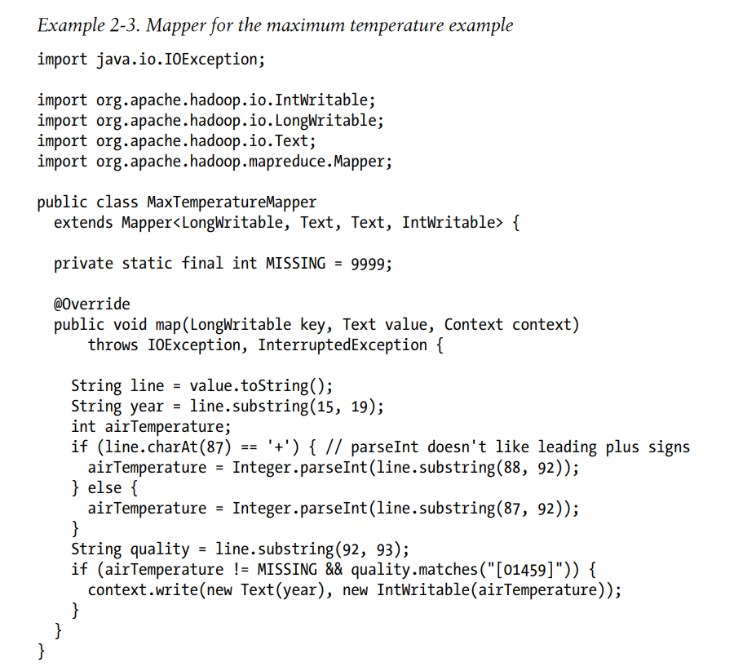

Slide 27
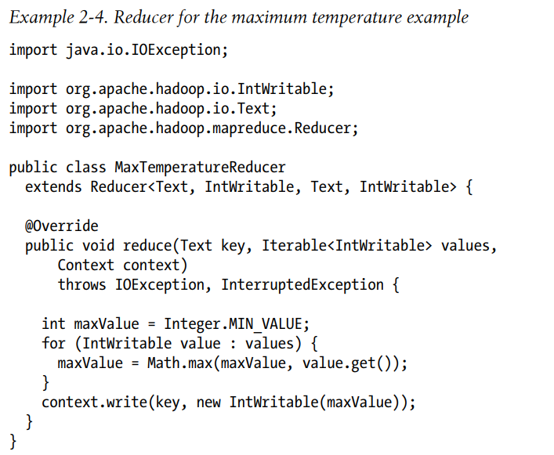

Slide 28
Scaling out
Expanding a system to handle larger amounts of data by adding more machines or nodes. Instead of relying on a single powerful computer to do all the work, you use many computers working together.
However, to scale out, we need to store the data in a distributed filesystem, typically HDFS to allow Hadoop to move the MapReduce computation to each machine hosting a part of the data.

Slide 29
DataFlow:
A MapReduce job consists of the input data, the MapReduce program, and configuration information.
Hadoop runs the job by dividing it into map tasks and reduce tasks.
The jobtracker coordinates job execution by scheduling tasks on tasktrackers.
Tasktrackers execute tasks and send progress updates to the jobtracker.
The jobtracker tracks the overall progress of each job and reschedules tasks if they fail.
Hadoop divides the input to a MapReduce job into fixed-size pieces called input splits, or just splits.

Slide 30
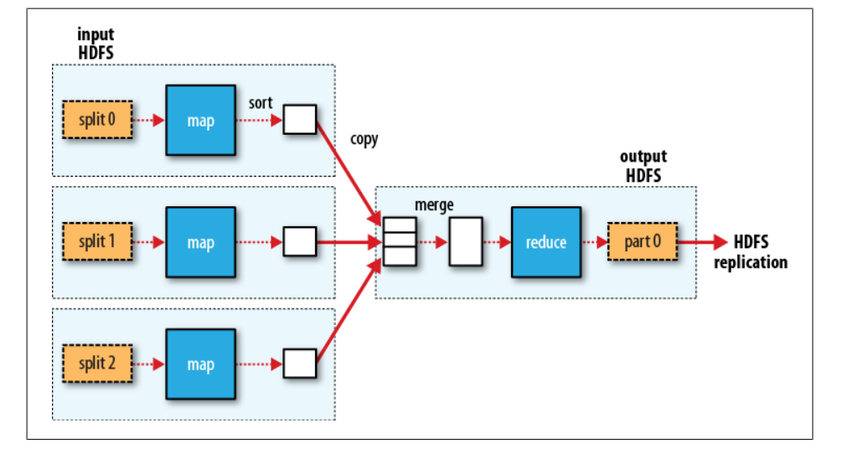
MapReduce data flow with a single reduce task

Slide 31
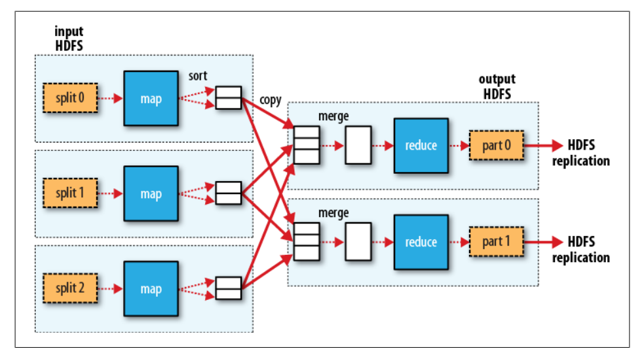
MapReduce data flow with multiple reduce tasks

Slide 32
Combiner Functions
Hadoop allows the user to specify a combiner function to be run on the map output, and the combiner function’s output forms the input to the reduce function.
Because the combiner function is an optimization, Hadoop does not provide a guarantee of how many times it will call it for a particular map output record, if at all.
In other words, calling the combiner function zero, one, or many times should produce the same output from the reducer.

Slide 33
Problem : For the maximum temperature example, readings for the year 1950 were processed by two maps (because they were in different splits). Imagine the first map produced the output:
(1950, 0)
(1950, 20)
(1950, 10)
and the second produced:
(1950, 25)
(1950, 15)
The reduce function would be called with a list of all the values:
(1950, [0, 20, 10, 25, 15]) with output: (1950, 25)

Slide 34
We could use a combiner function that, just like the reduce function, finds the maximum temperature for each map output. The reduce would then be called with:
Imagine the first map produced the output:
(1950, 0)
(1950, 20) (1950,20)
(1950, 10)
and the second produced:
(1950, 25)
(1950,25)
(1950, 15)
Combiner Result :
(1950, [20, 25]) and the reduce would produce the same output as before.
Output: (1950,25)

